Slide 1
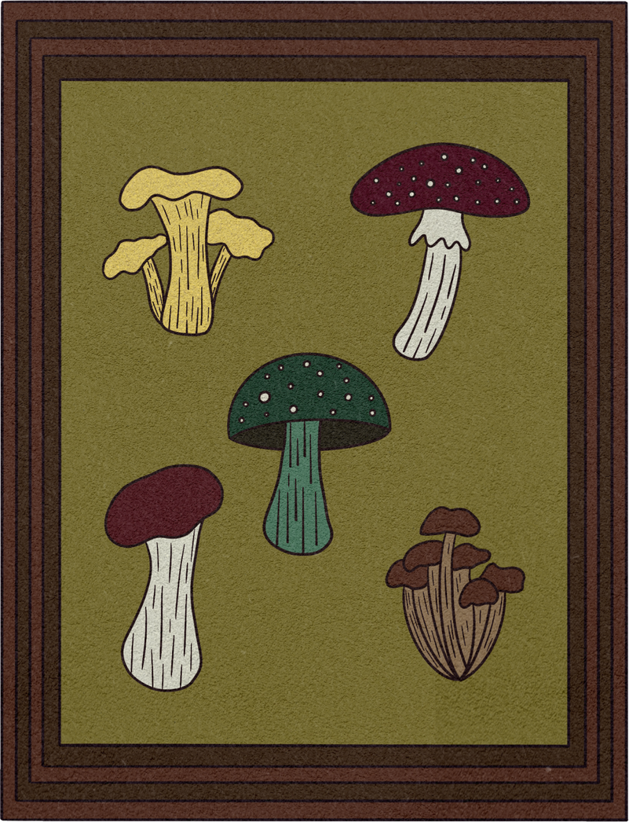

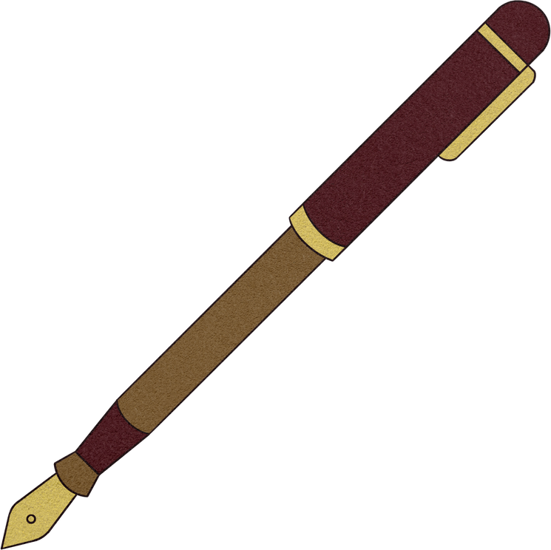
English Year 4
MODULE 3 - IN THE PAST

Slide 2

By the end of the lesson, pupils will be able to:
Understand with support, specific information and details of longer simple texts.
Recognise and reproduce with support a wide range of target language phonemes.
Find out about and describe experiences in the past.
Recognise and use with little or no support key features of a simple monolingual dictionary.

Slide 3
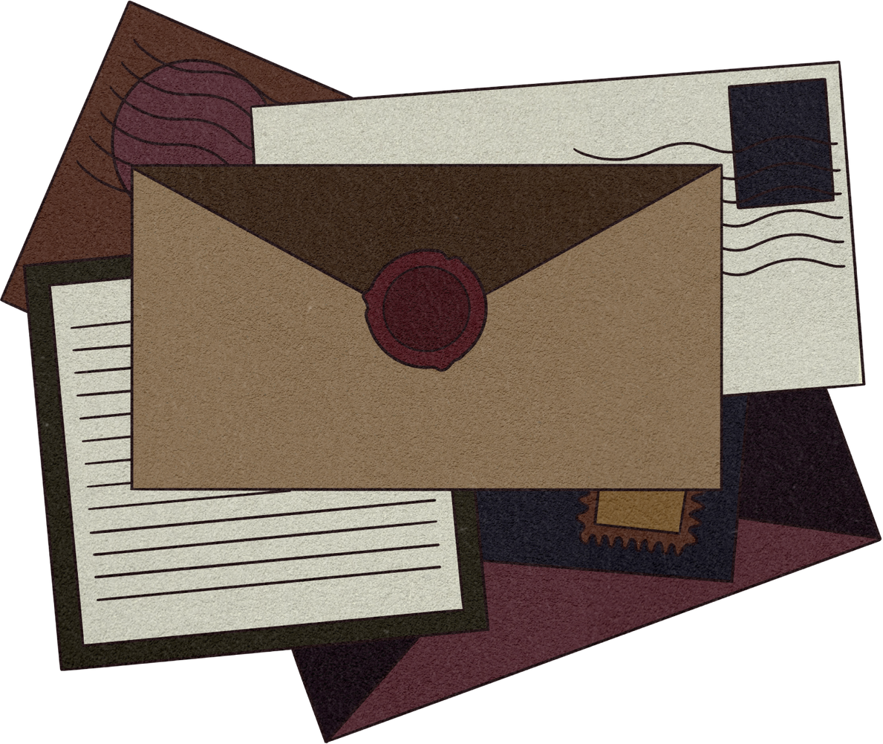
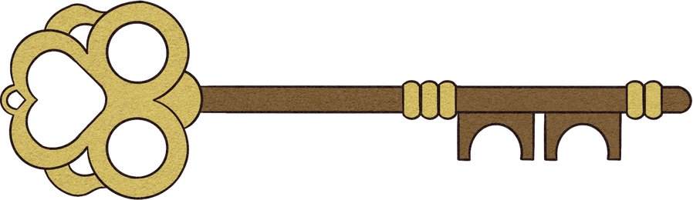
What we'll discuss
Today, we are going to learn about the past. Let us travel back in time to the ancient times of Egypt. Throughout this journey we will be learning past tense as well.

Slide 4
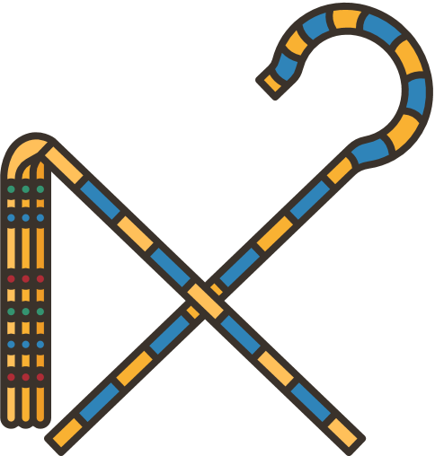

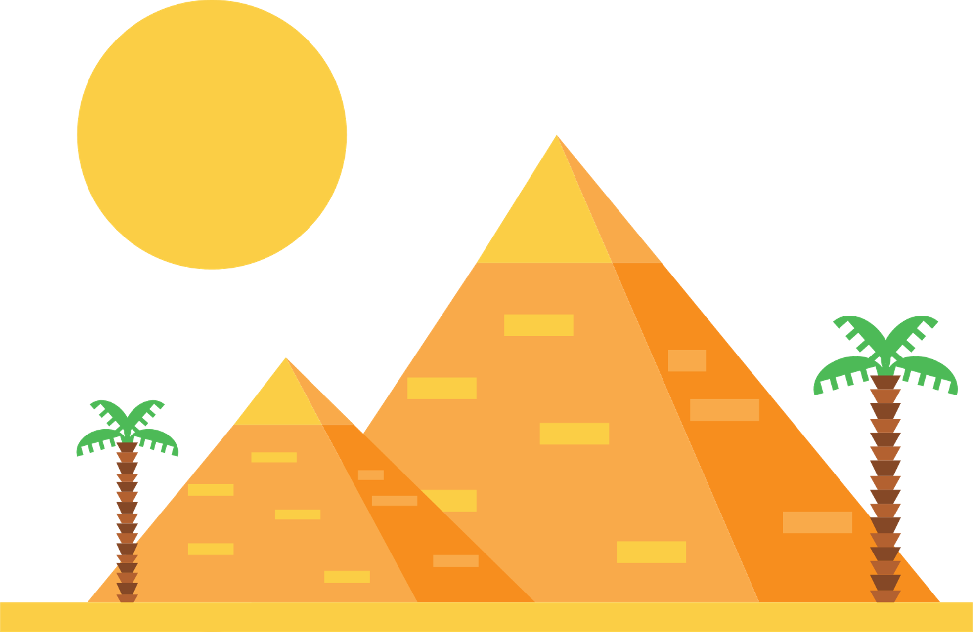
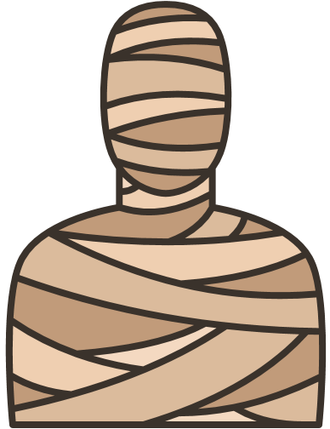
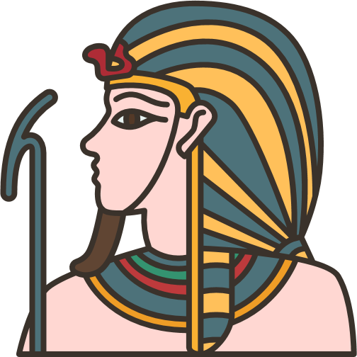
What do you think when you see these pictures?

Slide 5
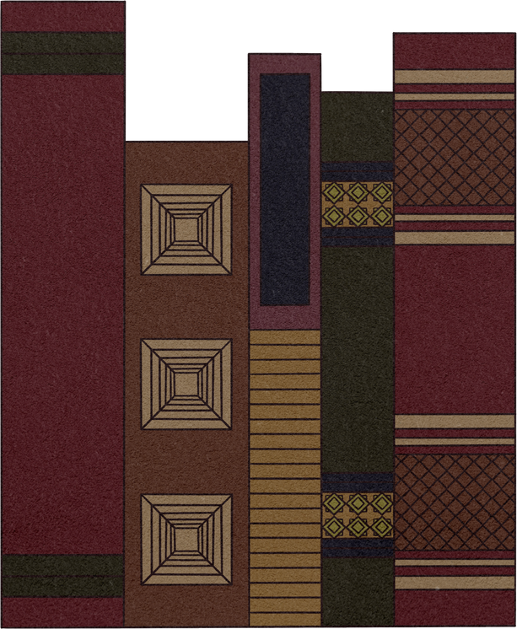
Fun Facts of Egypt
The ancient Egyptians worshipped over 2,000 gods and goddesses.
Cleopatra, Egypt’s last pharaoh, lived closer to our time than to the building of the Pyramids at Giza.
Ancient Egyptian bakers sometimes kneaded bread dough with their feet.
These ancient people often referred to their pet cats as miu. (Sound familiar?)

Slide 6
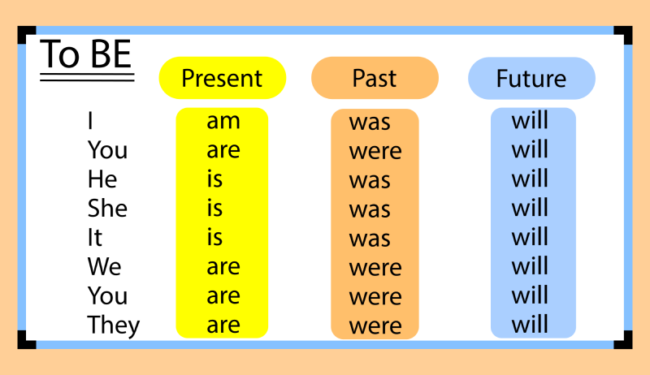
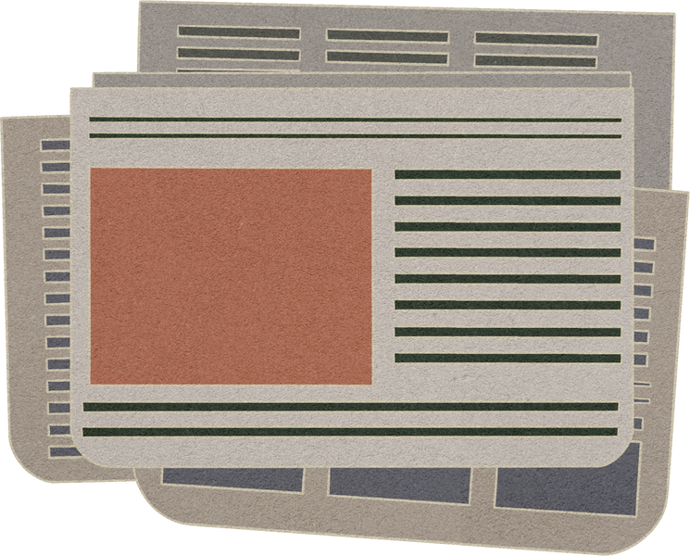
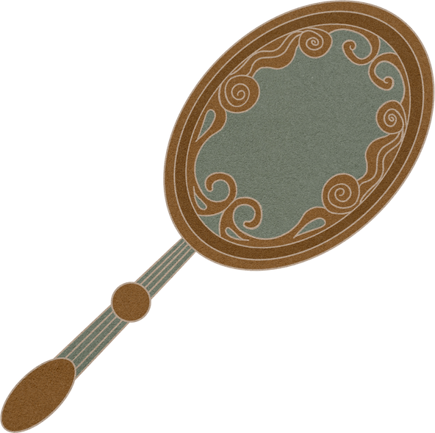
Let's construct some sentences using past tense

Slide 7
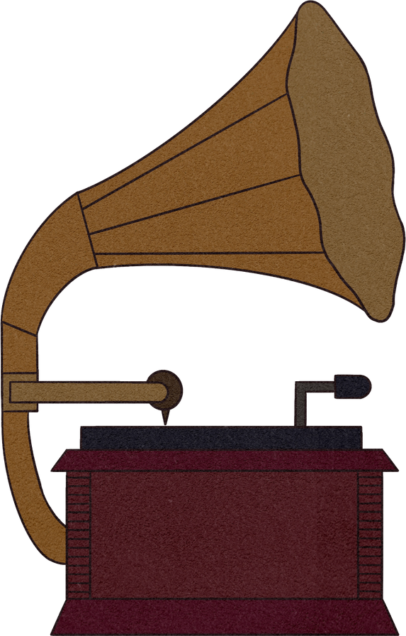
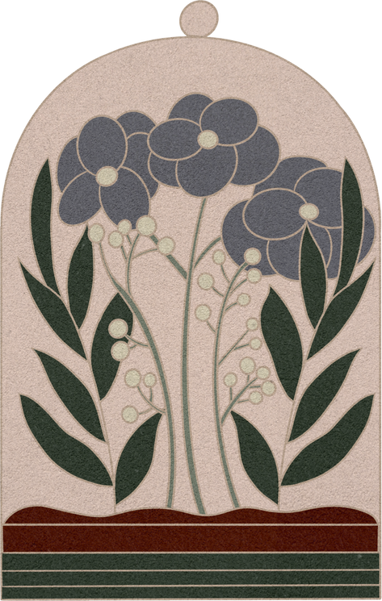
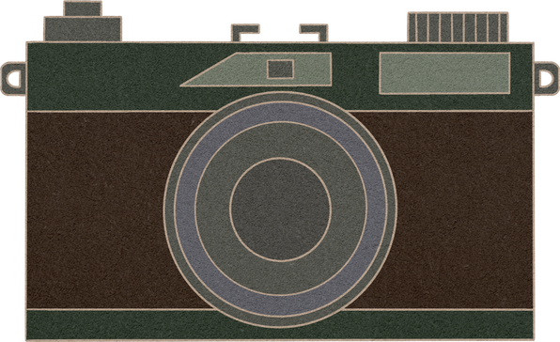
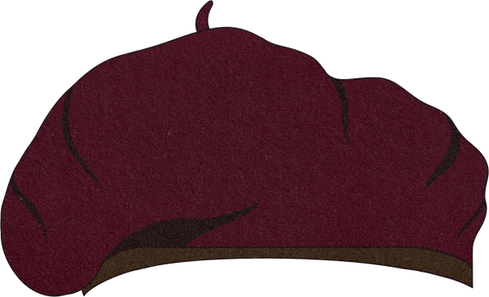
Thank You
for listening!

